Slide 1
UNIT -4
PROJECT MANAGEMENT

Slide 2
INTRODUCTION
Project:
It is combination of interrelated activities which must be executed in a certain order to achieve a set goals.
Network Analysis:
The OR techniques used for planning, scheduling and controlling large and complex projects are often referred to as Network analysis or Network Planning and Scheduling Techniques.
Network analysis refers to a number of techniques for the planning and controlling of complex problems.

Slide 3
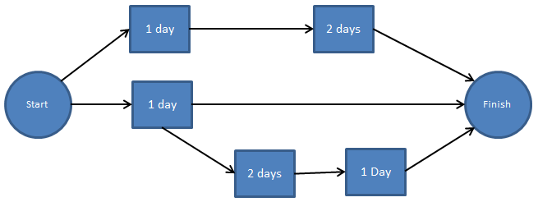
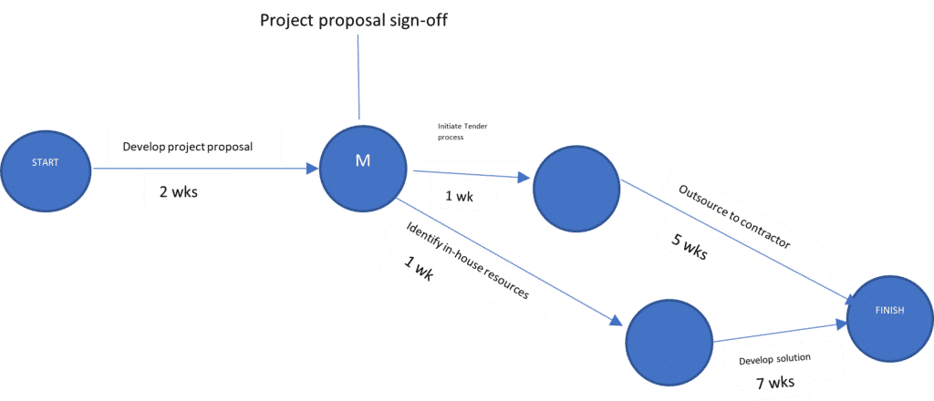
Network
It is the graphical representation of logically and sequentially connected arrows and nodes representing activities and events of a project

Slide 4
Early techniques of Project Management
Upto the end of 18th century decisions are depend on managerial capabilities, experience and academic background of managers.
In early 1900’s-Scientific management techniques were developed.
During World war 1, Henry L Gantt developed the Gantt chart for production scheduling.
Before PERT and CPM were developed Gantt charts and Milestone Charts were used as a tools to monitor the progress of complex projects.
Gantt chart was later modified to Bar charts.
Bar charts were used for both project and production scheduling.

Slide 5
Terminology used in Network Analysis
Activity: Any individual operation which utilizes resources and has an end and a beginning is called activity.
Predecessor activity : Activities that must be completed immediately prior to the start of another activity are called predecessor activities.
Successor activity : Activities that cannot be started until one or more of other activities are completed but immediately succeed them are called successor activities.
Concurrent activity : Activities which can be accomplished concurrently are known as concurrent activities
Dummy activity : An activity which does not consume any kind of resource but merely depicts the technological dependence is called a dummy activity.

Slide 6
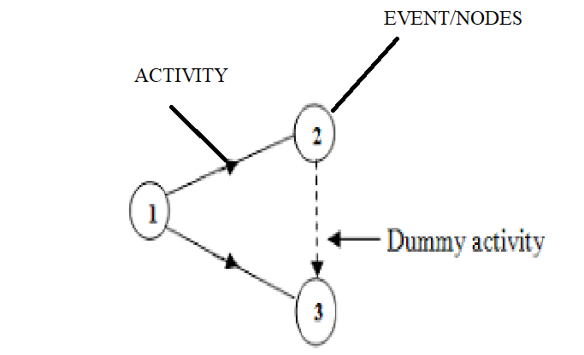
Terminology used in Network Analysis

Slide 7
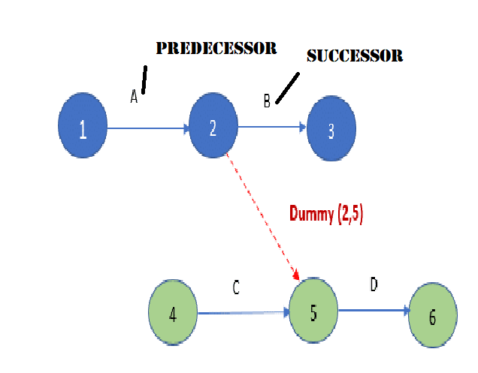

Slide 8
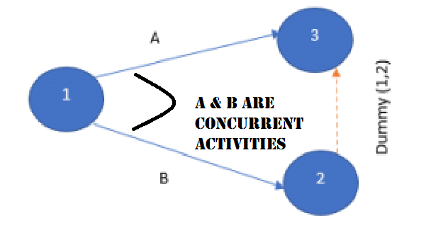

Slide 9
Terminology used in Network Analysis
Path: An unbroken chain of activity arrows connecting the initial event to some other event is called a path.
Event: An event represents a point in time signifying the completion of some activities and the beginning of new ones. This is usually represented by a circle in a network which is also called as a node.
Merge event: When more than one activity comes and joins an event such an event is known as Merge event.
Burst event: When more than one activity leaves an event such an event is known as Burst event.
Merge and Burst event: An activity may be merge and burst event at the same time as with respect to some activities it can be a merge event and with respect to some other activities it may be a burst event.

Slide 10
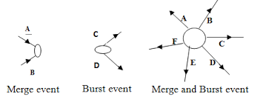
Types of Events
If two or more activities has same end event is merge event
If two or more activities has same start event is Burst event
If two or more activities start event and two or more other activities end event is same then it is Merge event and Burst event

Slide 11
Sequencing
To develop a network it is important to maintain precedence relationship.
The following points should be taken into consideration:
What job or jobs precede it?
What job or jobs could run concurrently?
What job or jobs follow it?

Slide 12
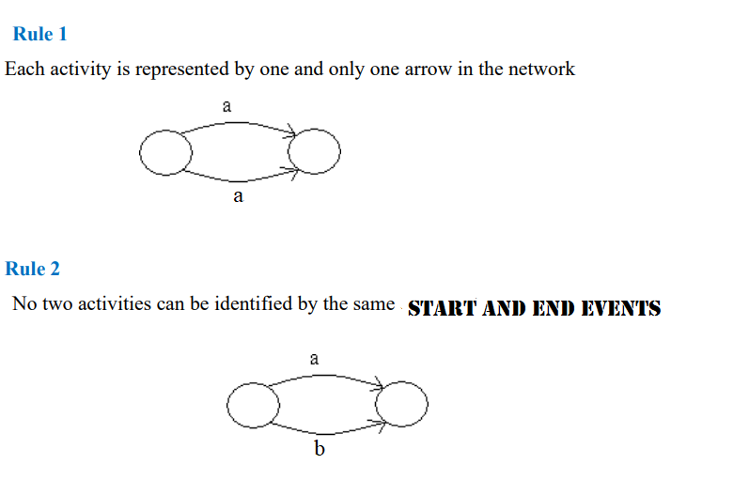
Rules for drawing Network Diagram

Slide 13
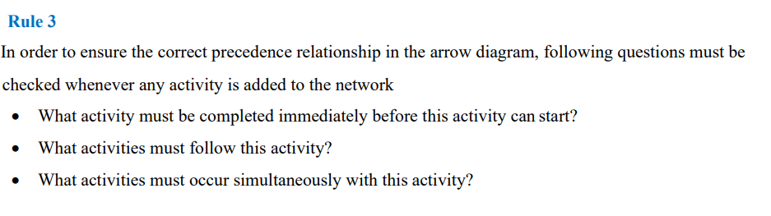

Slide 14
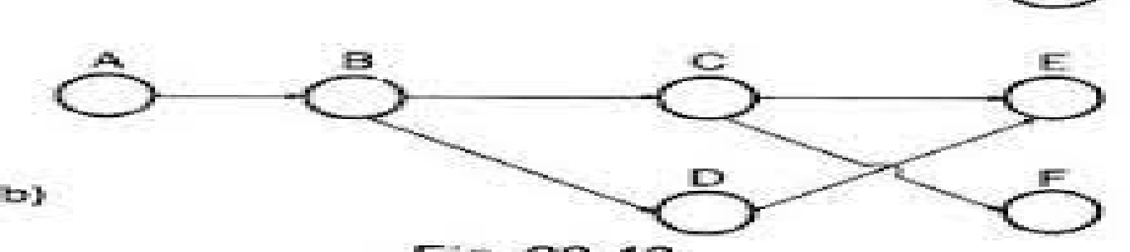
4. The flow of diagram should be from left to right.
5. A complete network should have only one point of entry event and one point of exit event.
6. All the activities must be tied in the network none of the events should be left untied into the network
7. An arrow should always be straight not curved.
8. Activity should not be crossed

Slide 15
9. No activity can start until its tail event is reached.
10. Arrow cannot go backward.
11. Use dummies only when it is required. The use of dummy activities should be minimised in the network.
12. The direction of the arrow indicates the direction of workflow. The normal convention is to go from left to right.

Slide 16
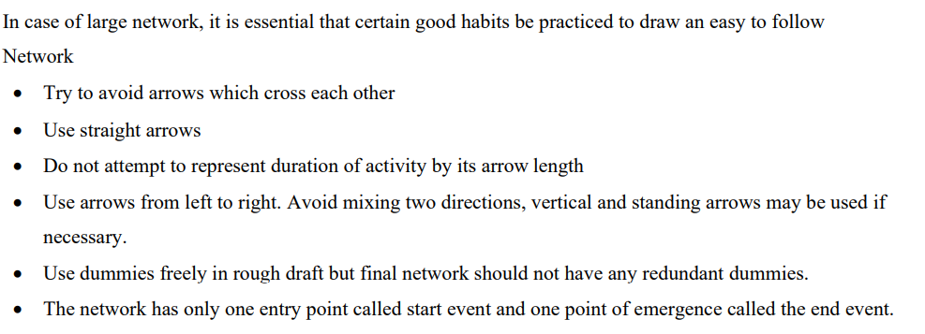
Suggestions

Slide 17
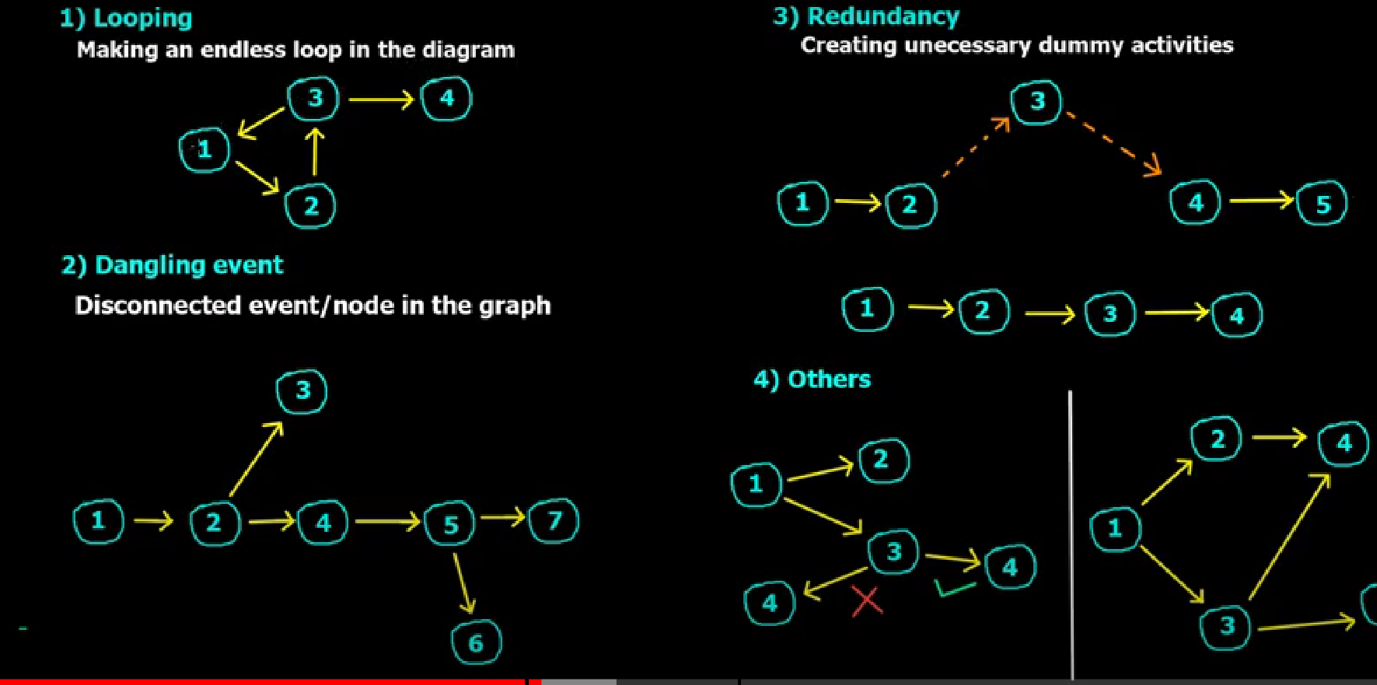
Common Errors in drawing Network

Slide 18
Numbering the Events
Fulkerson’s i-j rule:
A standard procedure called the i-j rule developed by D.R. Fulkerson is most commonly used for this purpose.
A start event is the one which has arrows emerging from it but none entering it. Find the start event and number it as unity(1).
Delete all arrows emerging from all numbered events, tis will create at least one new start event out of preceding events.
Number all new start events 2, 3, ……
Go on repeating step number 2 and 3 until the end is reached.

Slide 19
Draw the network diagram to the following activities
Activity | Time Duration
1-2 | 2
1-3 | 4
1-4 | 3
2-5 | 1
3-5 | 6
4-6 | 5
5-6 | 6

Slide 20
PERT and CPM
PERT and CPM are the most widely used techniques for planning and coordinating large-scale projects.
PERT (Program Evaluation and Review Technique) is primarily concerned with project time. It enables the project manager to schedule and coordinate the various activities so that the project can be completed on scheduled time.
CPM (Critical Path Method): The longest path through the network is called the critical path and its length determines the minimum duration in which said project can be completed.

Slide 21
CPM
CPM (Critical Path Method): The longest path through the network is called the critical path and its length determines the minimum duration in which said project can be completed.
All activities in the critical path are called Critical Activities.
The activity which does not lie on the critical path is called non- critical activity.
These non-critical activities may have some slack time.
The slack is the amount of time by which the start of an activity may be delayed without affecting the overall completion time of the project. But a critical activity has no slack.

Slide 22
Critical Path Method
Earliest Start Time (ES) : Earliest start time of an activity is the earliest time by which it can start.
Latest start time (LS): This is the very last minute in which you can start a task before it threatens to delay your project schedule
Earliest finish time (EF): The earliest an activity can be completed, based on its duration and its earliest start time
Latest finish time (LF): The latest an activity can be completed, based on its duration and its latest start time

Slide 23
Critical Path Method
Basic Scheduling Computations:
(i,j) = Activity (i,j) with tail event i and head event j.
Ei= Earliest occurrence time of event i
Lij= Latest allowable occurrence time of event j
Dij= Estimated completion time of activity(i,j)
(ES)ij= Earliest starting time of activity(i,j)
(EF)ij= Earliest finishing time of activity(i,j)
(LS)ij= Latest starting time of activity (i,j)
(Lf)ij = Latest finishing time of activity (i,j)

Slide 24
Critical Path Method
Forward Pass Computations: (To calculate Earliest Event Time)
(ES)ij = Ei
E=0
(EF)ij= (ES)ij+Dij or (EF)ij = Ei+Dij
Ej = max(Ei+Dij)
Backward Pass Computations: (To calculate Latest Allowable Time)
For ending event E=L
(LF)ij = Lj
(LS)ij = (LF)ij-Dij or (LS)ij= Lj-Dij
Li = min(Lj-Dij)

Slide 25
Critical Path Method
Determination of Floats and Slack times:
Total Float: Total float represents the maximum time within which an activity can be delayed without affecting the project completion time.
(TF)ij=(Latest Finish-Earliest Finish) for activity (i-j)
(TF)ij = (LF)ij-(EF)ij or (Lj-Ei)-Dij
Free Float: Free float is the time by which completion of an activity can be delayed without delaying its immediate successor activities.
(FF)ij = (Ej-Ei)-Dij or Total float-Slack of head event

Slide 26
Critical Path Method
Determination of Floats and Slack times:
Independent Float : Portion of the total float within which an activity can be delayed without affecting the floats of preceding activities.
(IF)ij = (Ej-Li)-Dij or Free float – Slack of tail event
The negative independent float is always taken as zero.
Slack: It is the time by which occurrence of an event can be delayed.
Slack = (Latest occurrence time – Earliest occrence time) of event
Slack of head event = Lj-Ej
Slack of tail event = Li-Ei

Slide 27
Critical Path Method
Determination of Critical Path:
Critical Event: The events with zero slack times are called “Critical events”
Critical Activity: Since the difference between the latest start time and earliest start time of an activity is usually called as total float. The activities with zero total float are known as Critical Activities.
Critical Path: The sequence of critical activities in a network is called as the critical path.

Slide 28
PERT
Program (Project) Evaluation and Review Technique(PERT) is a project management tool used to schedule , organize, and coordinate tasks within a project.
It is basically a method to analyze the tasks involved in completing a given project, especially the time needed to complete each task, and to identify the minimum time needed to complete the total project.
The main objective of PERT is to facilitate decision making and to reduce both the time and cost required to complete a project.

Slide 29
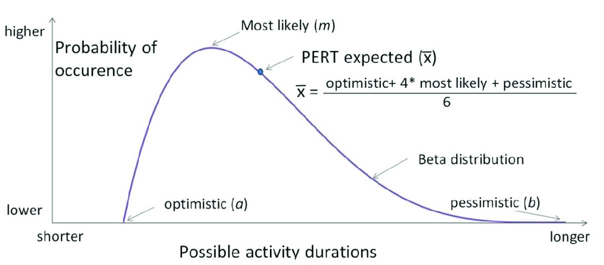
PERT

Slide 30
PERT
In the PERT three time values are used as follows:
Optimistic Time (To) : It is the minimum possible time required to complete the task anticipating that every event has occurred better than usually expected.
Pessimistic Time (Tp) : This means the maximum possible time required to complete the given task, expecting or assuming everything goes wrong except the main catastrophes.
Most Likely Time (Tm) : The actual and the best time required to complete the task assuming everything goes in a usual way.

Slide 31
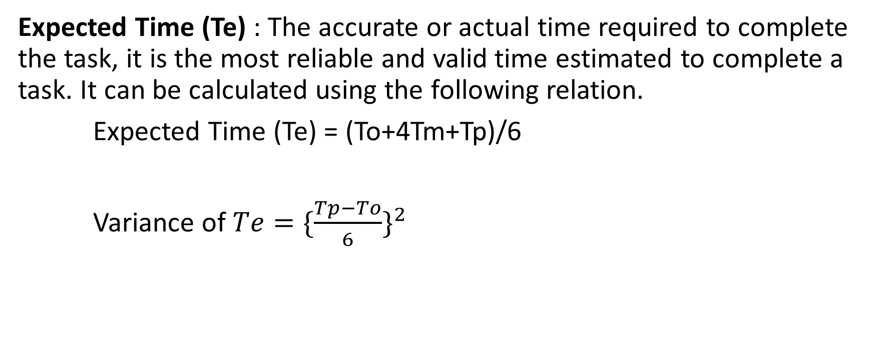
PERT
Expected Time (Te) : The accurate or actual time required to complete the task, it is the most reliable and valid time estimated to complete a task. It can be calculated using the following relation.
Expected Time (Te) = (To+4Tm+Tp)/6
Variance of $Te={\{\frac{Tp−To}{6}\}}^{2}$

Slide 32
PERT vs. CPM
PERT | CPM
PERT is a project management technique, used to manage uncertain activities (time is not known) of a project. | CPM is a statistical technique of project management that manages well defined activities (time is known) of a project.
A technique of planning and control of time | A method to control cost and time.
Evolved as a Research & Development Project | Evolved as a Construction Project
Event Oriented | Activity Oriented
Probabilistic Model | Deterministic Model
It has three time estimates To,Tm,Tp | It has only one time estimate.
It does not distinguish between critical and non-critical activities | It demarcates critical activities
Used for non-repetitive jobs like research and development project. | Used for repetitive job – like civil construction, ship building etc.,

